Slide 1
DESCRIBE AN IMAGE
Name : Kumar Kislay
Roll No : 1809110082

Slide 2
OVERVIEW
PROBLEM STATEMENT –
We want to create a model/web application that takes an image as an input and produces its relevant description as an output.

Slide 3
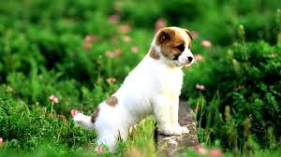
INTRODUCTION
What do you see in the below picture?
Well some of you might say “A white dog in a grassy area”, some may say “White dog with brown spots” and yet some others might say “A dog on grass and some pink flowers”.
Definitely all of these captions are relevant for this image and there may be some others also. But the point I want to make is; it’s so easy for us, as human beings, to just have a glance at a picture and describe it in an appropriate language. Even a 5 year old could do this with utmost ease.
But, can you write a computer program that takes an image as input and produces a relevant caption as output?

Slide 4
DESCRIPTION OF DATASET
Dataset used – Flickr8k dataset
This dataset contains 8000 images each with 5 captions (as we have already seen in the Introduction section that an image can have multiple captions, all being relevant simultaneously).
These images are bifurcated as follows:
Training Set — 6000 images
Dev Set — 1000 images
Test Set — 1000 images

Slide 5
HOW IS IT DONE?
Images are nothing but input (X) to our model. As you may already know that any input to a model must be given in the form of a vector.
We need to convert every image into a fixed sized vector which can then be fed as input to the neural network. For this purpose, we opt for transfer learning by using the ResNet50 model.
Our purpose here is not to classify the image but just get fixed-length informative vector for each image. This process is called automatic feature engineering.
Hence, we just remove the last SoftMax layer from the model and extract a 2048 length vector for every image.

Slide 6
We must note that captions are something that we want to predict. So during the training period, captions will be the target variables (Y) that the model is learning to predict.
But the prediction of the entire caption, given the image does not happen at once. We will predict the caption word by word. Thus, we need to encode each word into a fixed sized vector. However, this part will be seen later when we look at the model design, but for now we will create two Python Dictionaries namely “wordtoix” (pronounced — word to index) and “ixtoword” (pronounced — index to word).
Stating simply, we will represent every unique word in the vocabulary by an integer (index). We have 1652 unique words in the corpus and thus each word will be represented by an integer index between 1 to 1652.
These two Python dictionaries can be used as follows:
wordtoix[‘abc’] -> returns index of the word ‘abc’
ixtoword[k] -> returns the word whose index is ‘k’

Slide 7
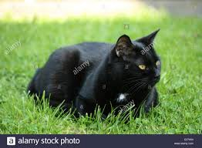
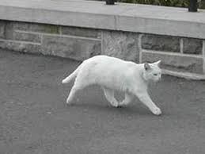
Training our model
Let us understand this with 2 examples
Caption -> The black cat sat on grass Caption -> The white cat is walking on road
Caption_1 -> “startseq the black cat sat on grass endseq”
Caption_2 -> “startseq the white cat is walking on road endseq”
vocab = {black, cat, endseq, grass, is, on, road, sat, startseq, the, walking, white}

Slide 8
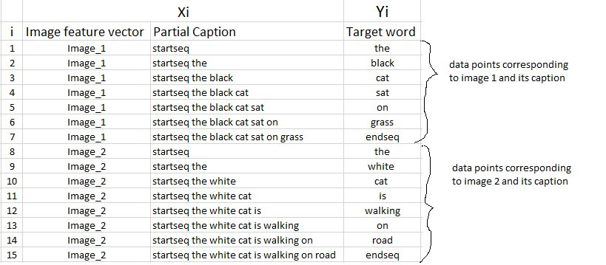
We train each image with giving the image and the partial caption as in input and telling the next word. This is a sequential model as we have to construct meaningful sentences, therefore we use Recurrent Neural Network(LSTM Mode) for this purpose.

Slide 9
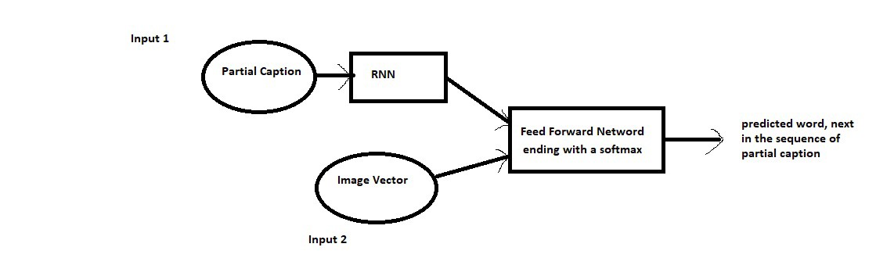
we will map the every word (index) to a 50-long vector and for this purpose, we will use a pre-trained GLOVE Model. We used Glove 6B 50D.
Since the input consists of two parts, an image vector and a partial caption, we cannot use the Sequential API provided by the Keras library. For this reason, we use the Functional API which allows us to create Merge Models.
Our model architecture -

Slide 10
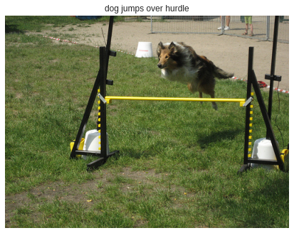
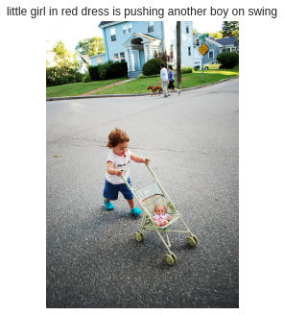
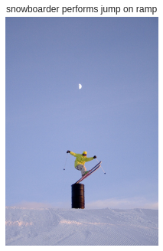
Visualizing some results

Slide 11
TECHNOLOGY STACK
-TECHNOLOGIES USED
Machine learning /Data analytics: used for making backend
Web technologies : used for making frontend and user interface.
-FRAMEWORKS USED
Google colab (for Machine Learning), Python, Flask, HTML, CSS, Bootstrap
GITHUB PROJECT LINK -
https://github.com/kislay960/Describe-an-image

Slide 12
APPLICATIONS OF THIS PROJECT
Few applications where a solution to this problem can be very useful.
Self driving cars — Automatic driving is one of the biggest challenges and if we can properly caption the scene around the car, it can give a boost to the self driving system.
Aid to the blind — We can create a product for the blind which will guide them travelling on the roads without the support of anyone else. We can do this by first converting the scene into text and then the text to voice. Both are now famous applications of Deep Learning.
CCTV cameras are everywhere today, but along with viewing the world, if we can also generate relevant captions, then we can raise alarms as soon as there is some malicious activity going on somewhere. This could probably help reduce some crime and/or accidents.
Automatic Captioning can help, make Google Image Search as good as Google Search, as then every image could be first converted into a caption and then search can be performed based on the caption.

Slide 13
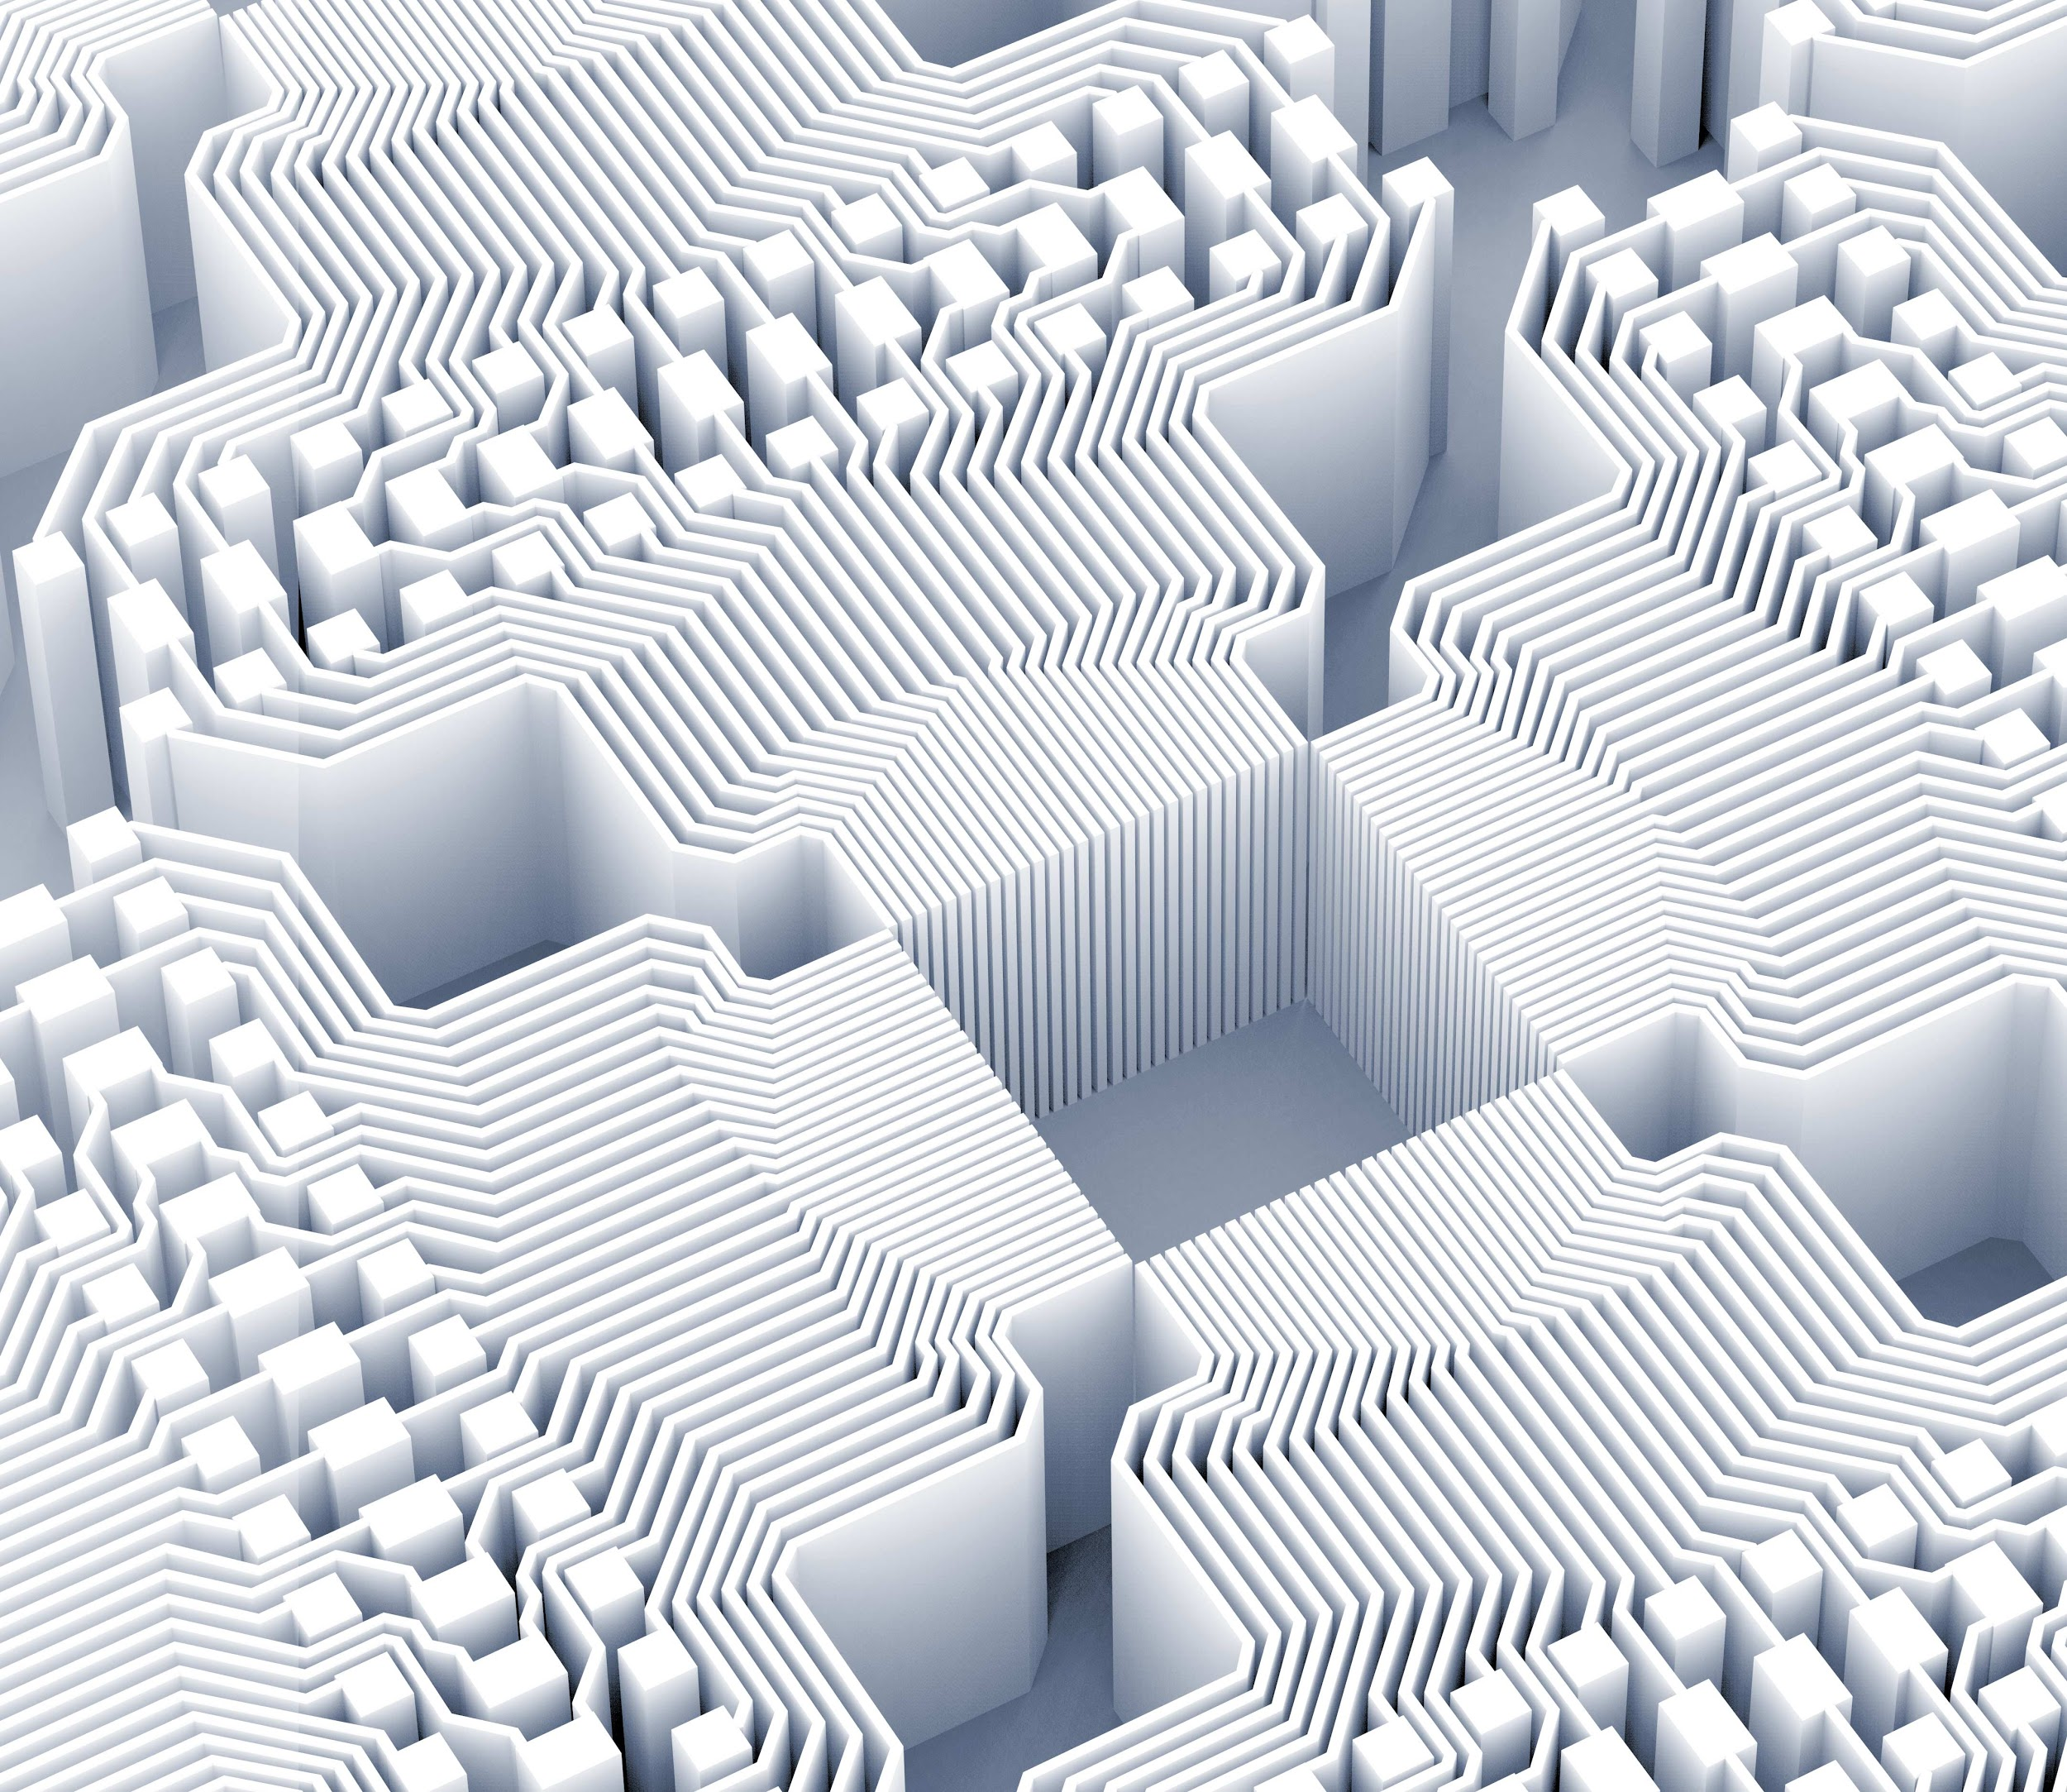
Thank you!

